Slide 1
11kW OBC CLLLC CV Forward
Lim Shu Fan
26.4.2022

Slide 2
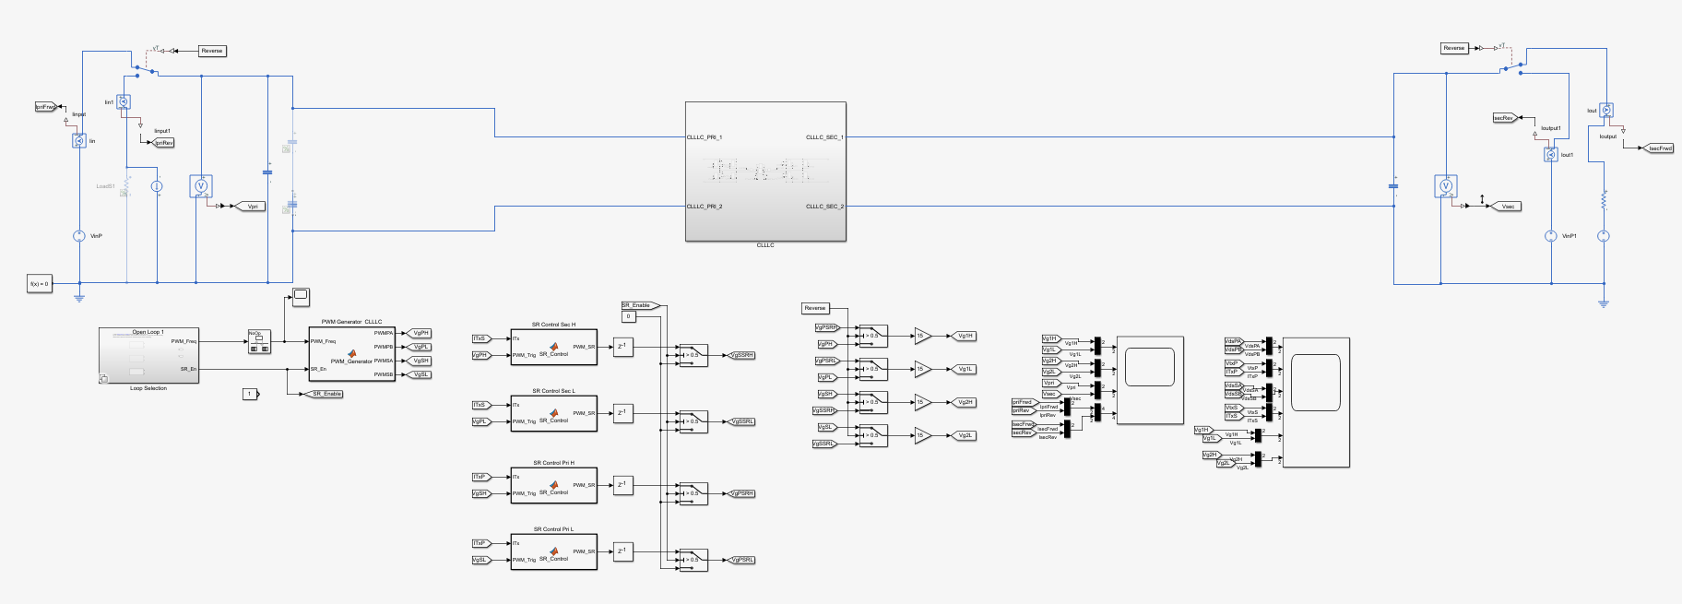

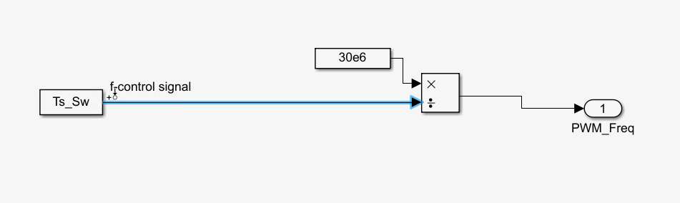
Getting the plant transfer function (Ts to Vo for CV in Forward mode)
Output signal– Output voltage
Operating point
Vin = 800V
Vout = 400V
Iout = 27.5A
Fsw = 51.5kHz
Input perturbation – switching period

Slide 3
Steps to get Bode plots in MATLAB
Go to Apps -> linearization manager -> select the switching period as input perturbation and output voltage as output signal
Go to Apps -> Model linearizer -> estimation tab
In Estimation tab -> Model initial conditions -> take simulation snapshot -> put in simulation steady state time
In Estimation tab -> input signal -> select fixed sample time sinestream
Sample time -> 1e-7 (if 50e-6, can only measure frequency range up to 10kHz)
Frequency unit -> Hz
Add new frequencies to the signals -> 10Hz to 100k/200kHz, number of frequencies 30/50
Select all the frequencies and change amplitude to 100/40 (because switching period in digital value)
Select Bode and simulation will start

Slide 4
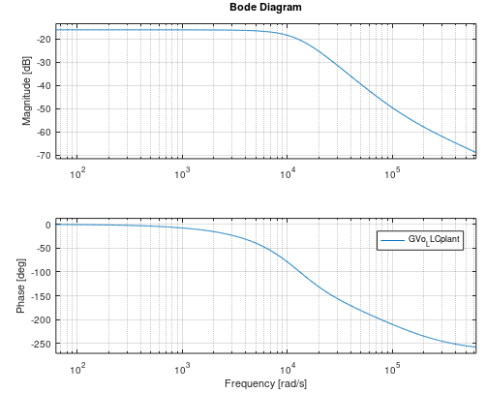
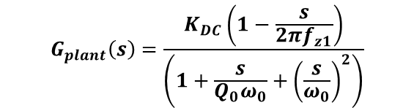
The plant transfer function (open loop sweep) 400V output 11kW
$$G_{plant}\left(s\right)=\frac{K_{DC}\left(1−\frac{s}{2πf_{z1}}\right)}{\left(1+\frac{s}{Q_{0}ω_{0}}+{\left(\frac{s}{ω_{0}}\right)}^{2}\right)}$$
GDC=-16.0418dB, KDC=10^(GDC/20), Q0=0.63, f0=2kHz, fz1= 18kHz
Operating point
Vin = 800V
Vout = 400V
Iout = 27.5A
Fsw = 51.5kHz

Slide 5
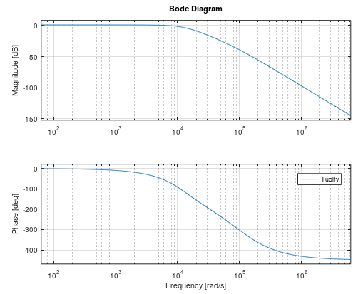
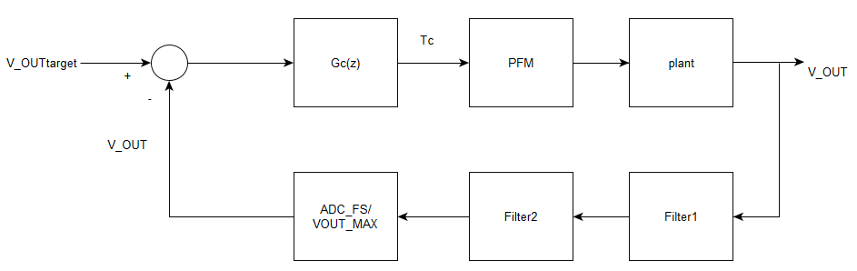
The uncompensated open loop gain 400V output 11kW
CLLLC switching frequency ranges from 48kHz at maximum load under maximum output voltage to 240kHz at light load under minimum output voltage.
Choose CLLLC crossover frequency to be 1/30 of minimum switching frequency at 1.6kHz.
To compensate the 2 resonant pole, 2 zeros are needed. A high frequency pole is needed to attenuate high frequency switching noise while an integrator is needed for high DC gain. A 2P2Z compensator is designed.

Slide 6
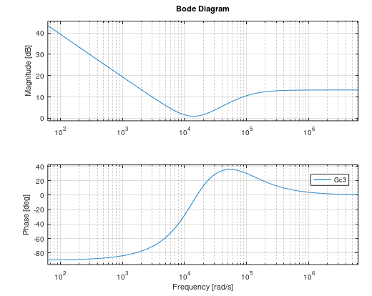
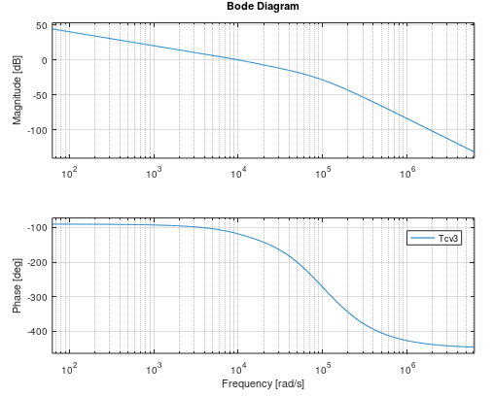
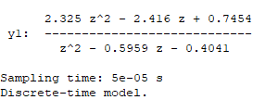
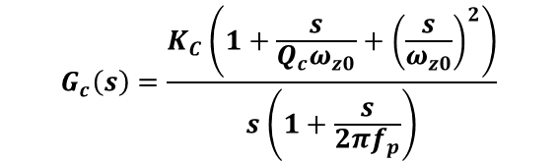
2P2Z compensator design (50us)
Compensator transfer function
Compensated loop gain
Design parameters
Fz0 =2.2kHz
Qc =0.6
Fp= 15kHz
Gfc=-79.4dB
Kc=1/(10^(Gfc/20))
Design Output
Fc =1.6kHz
PM =61.5deg
GM=-14dB
$$G_{c}\left(s\right)=\frac{K_{C}\left(1+\frac{s}{Q_{c}ω_{z0}}+{\left(\frac{s}{ω_{z0}}\right)}^{2}\right)}{s\left(1+\frac{s}{2πf_{p}}\right)}$$
Tustin

Slide 7
2P2Z compensator design (50us)
In floating point implementation (using ADC values directly),
u0_v = (a0_v*e0_v) + (a1_v*e1_v) + (a2_v*e2_v) - (b1_v*u1_v) - (b2_v*u2_v);
a0_v = 2.325;
a1_v = -2.416;
a2_v = 0.7454;
b1_v = -0.5959;
b2_v = -0.4041;

Slide 8
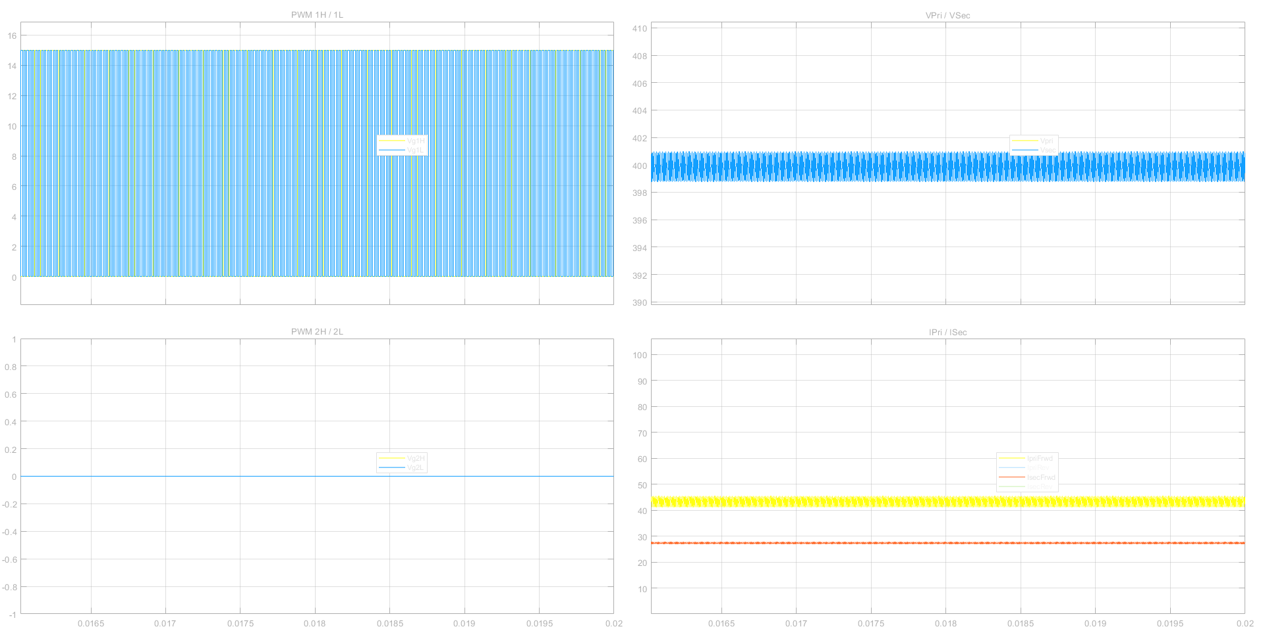
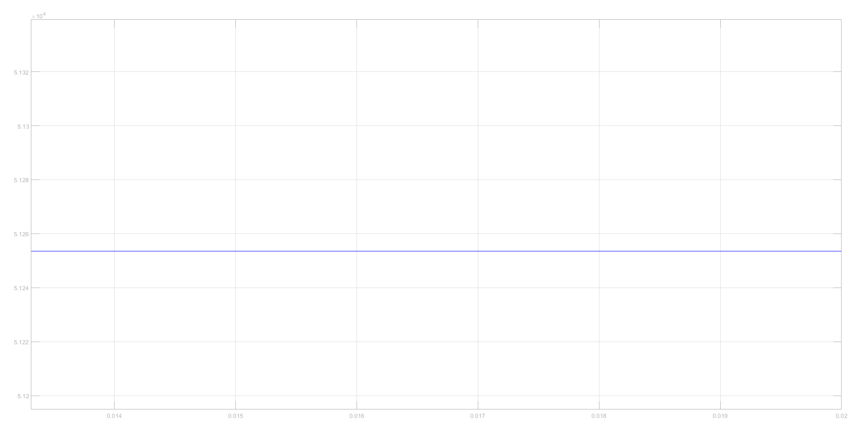
At 800V input, 400V output and 11kW,
But not regulating at 800V input, 250V output and 9.25kW

Slide 9
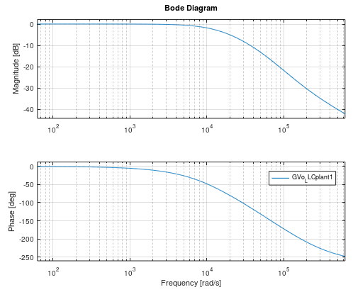
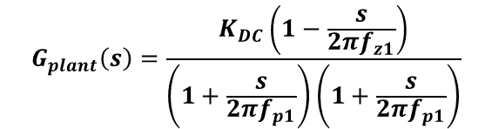
The plant tranfer function (open loop sweep) 250V output 9.25kW
$$G_{plant}\left(s\right)=\frac{K_{DC}\left(1−\frac{s}{2πf_{z1}}\right)}{\left(1+\frac{s}{2πf_{p1}}\right)\left(1+\frac{s}{2πf_{p1}}\right)}$$
GDC=0.145596dB, KDC=10^(GDC/20), fz1= 28kHz, fp1=2.3kHz, fp2=9kHz
Operating point
Vin = 800V
Vout = 250V
Iout = 37A
Fsw = 83kHz

Slide 10
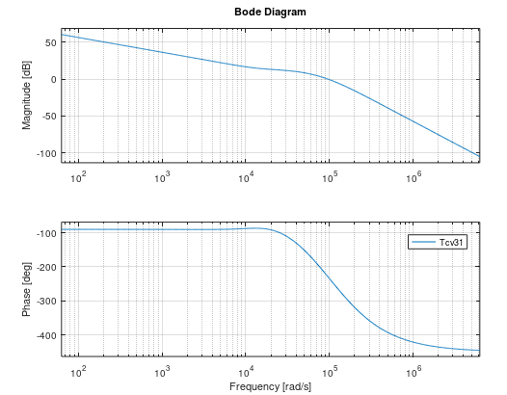
Instability at 250V 9.25kW with the controller designed at 400V 11kW
At crossover frequency, the phase is beyond -180 and is instable.
Should design at 250V (higher bandwidth) and check for 400V operation (lower bandwidth).

Slide 11
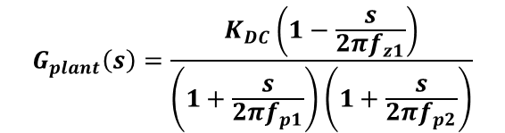
Plant at 400V 11kW and 250V 9.25kW respectively
$$G_{plant}\left(s\right)=\frac{K_{DC}\left(1−\frac{s}{2πf_{z1}}\right)}{\left(1+\frac{s}{Q_{0}ω_{0}}+{\left(\frac{s}{ω_{0}}\right)}^{2}\right)}$$
$$G_{plant}\left(s\right)=\frac{K_{DC}\left(1−\frac{s}{2πf_{z1}}\right)}{\left(1+\frac{s}{2πf_{p1}}\right)\left(1+\frac{s}{2πf_{p2}}\right)}$$
GDC=-16.0418dB, KDC=10^(GDC/20), Q0=0.63, f0=2kHz, fz1= 18kHz
GDC=0.145596dB, KDC=10^(GDC/20), fz1= 28kHz, fp1=2.3kHz, fp2=9kHz

Slide 12
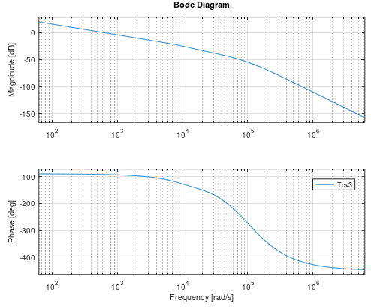
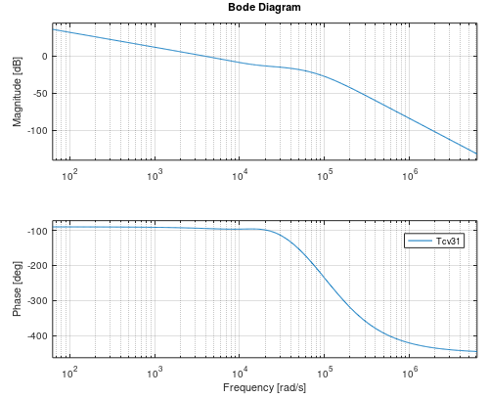

2P2Z compensator design (50us)
Compensated loop gain 400V 11kW
Compensated loop gain 250V 9.25kW
Design Output
Fc =100.3Hz
PM =87.5deg
GM=-40dB
Design Output
Fc =636.6Hz
PM =85deg
GM=-20dB
Design parameters
Fz0 =2.5kHz
Qc =0.63
Fp= 15kHz
Gfc=-55dB
Kc=1/(10^(Gfc/20))
$$G_{c}\left(s\right)=\frac{K_{C}\left(1+\frac{s}{Q_{c}ω_{z0}}+{\left(\frac{s}{ω_{z0}}\right)}^{2}\right)}{s\left(1+\frac{s}{2πf_{p}}\right)}$$
Tustin

Slide 13
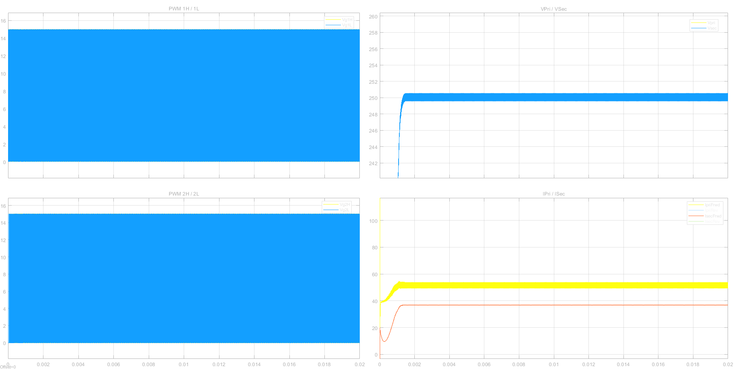
At 800V input, 250V output and 9.25kW,

Slide 14
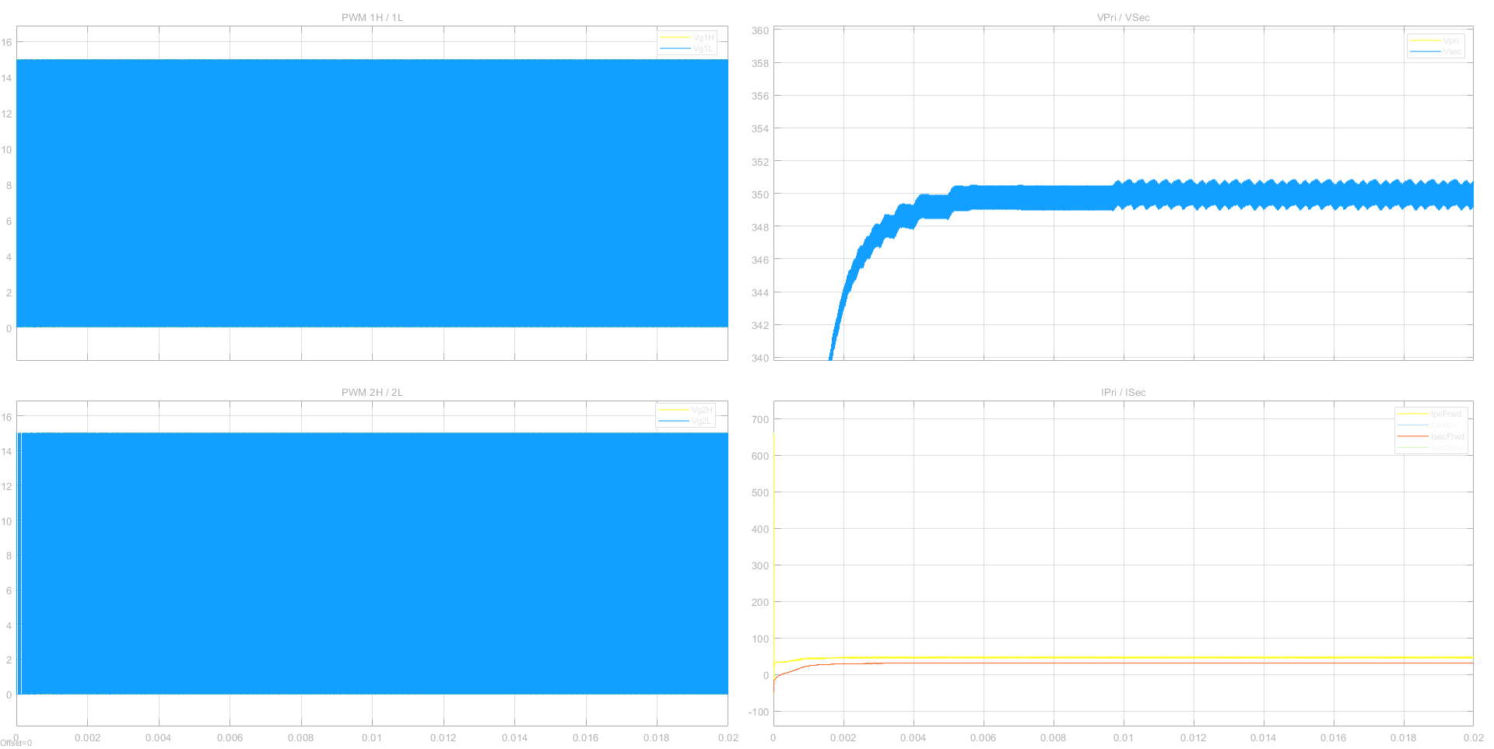
At 800V input, 350V output and 11kW,

Slide 15
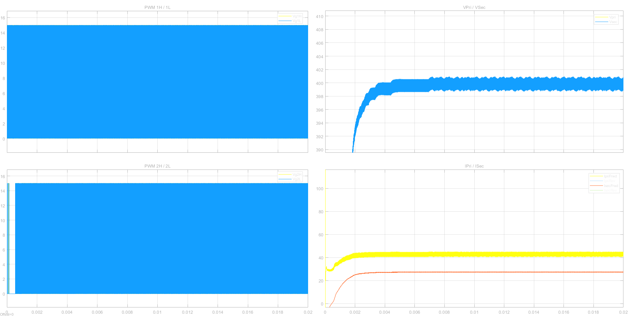
At 800V input, 400V output and 11kW,

Slide 16
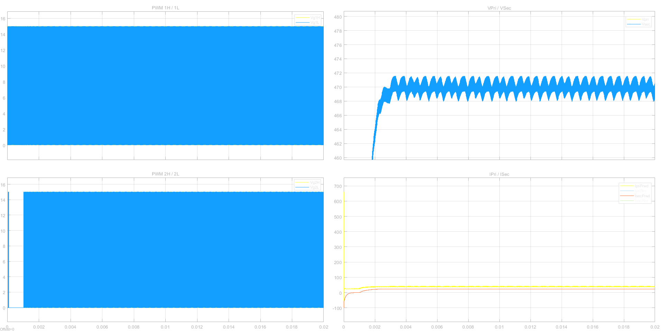
At 800V input, 470V output and 11kW,
Output ripple specs is +/-2% of output voltage.
At 470V, output ripple should be < +/-9.4V.

Slide 17
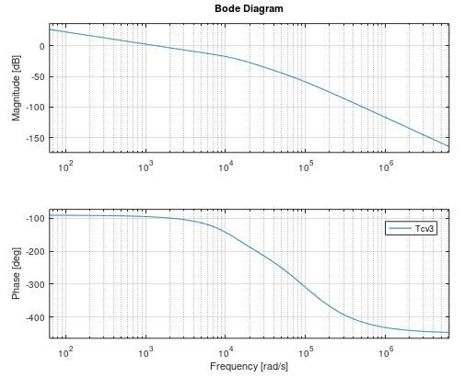
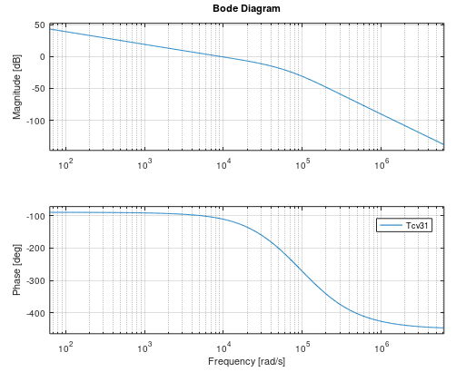


PI compensator design (50us)
Compensated loop gain 400V 11kW
Compensated loop gain 250V 9.25kW
Design Output
Fc =238.7Hz
PM =84deg
GM=-25dB
Design Output
Fc =1432.4Hz
PM =70deg
GM=-15dB
Design parameters
FzL =2kHz
Gfc=20dB
KL=1/(10^(Gfc/20))
$$G_{c}\left(s\right)=K_{L}\left(1+\frac{2πf_{zL}}{s}\right)$$
Tustin

Slide 18
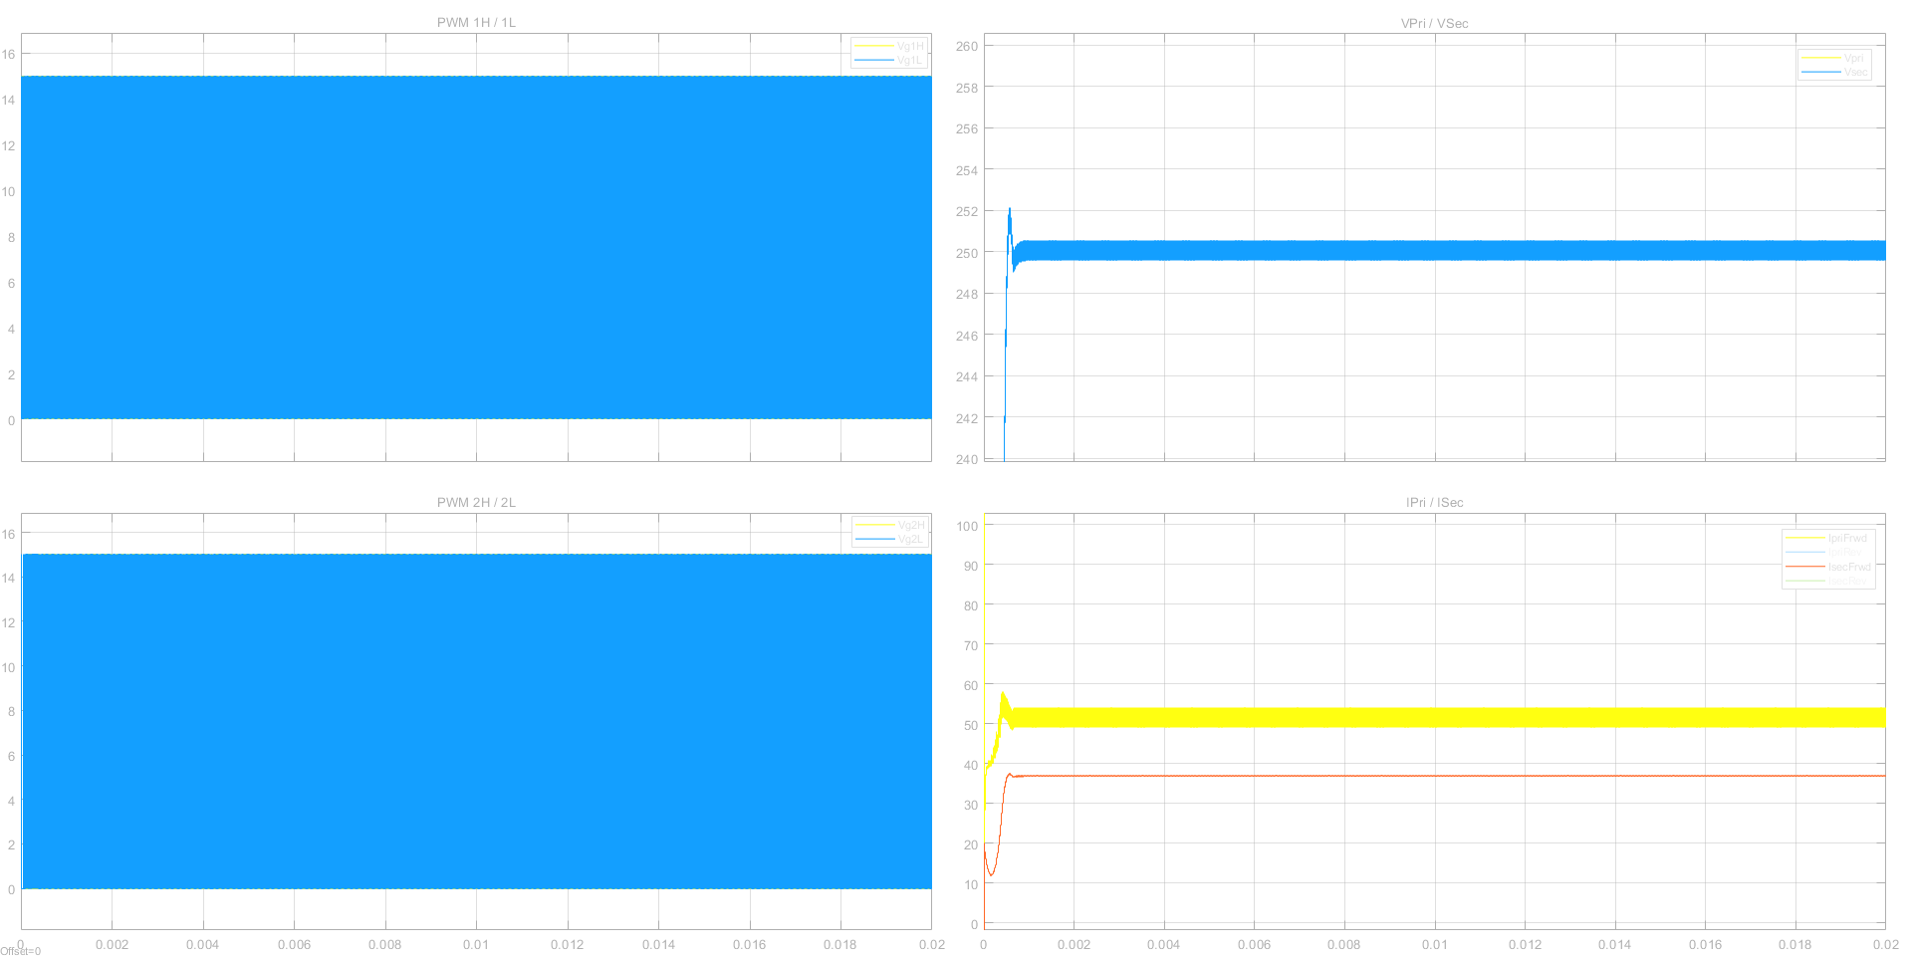
At 800V input, 250V output and 9.25kW,

Slide 19
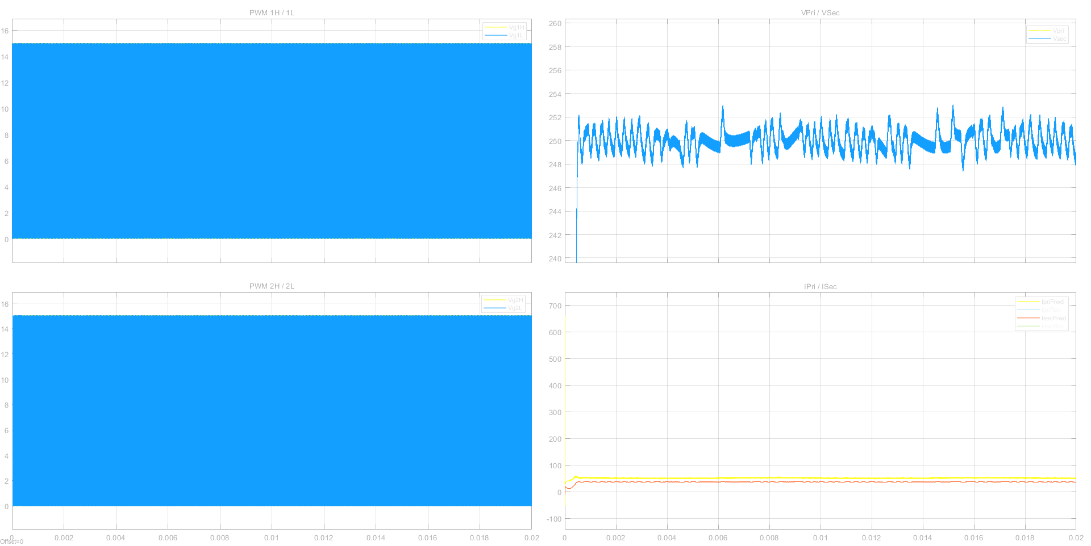
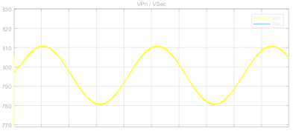
At 800V input with 30Vpp ripples at 120Hz, 250V output and 9.25kW,
Output ripple specs is +/-2% of output voltage.
At 250V, output ripple should be < +/-5V.

Slide 20
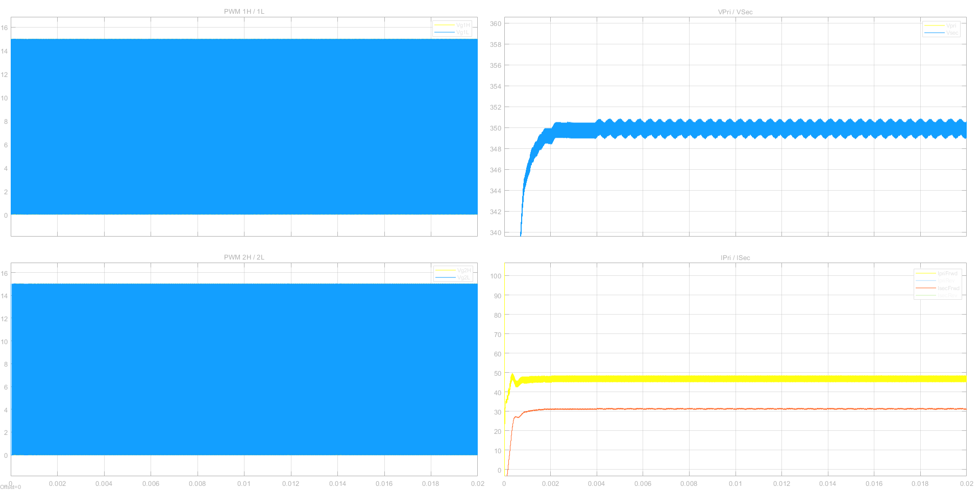
At 800V input, 350V output and 11kW,

Slide 21
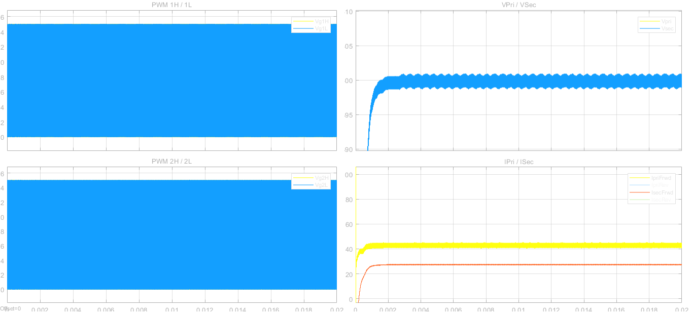
At 800V input, 400V output and 11kW,

Slide 22
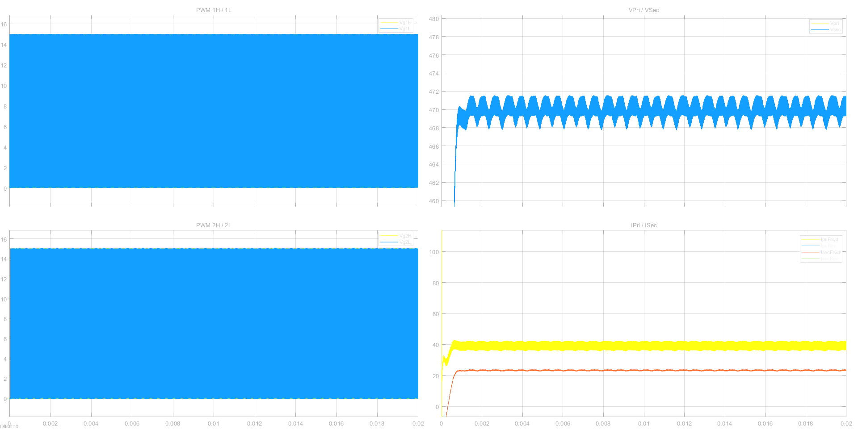
At 800V input, 470V output and 11kW,

Slide 23
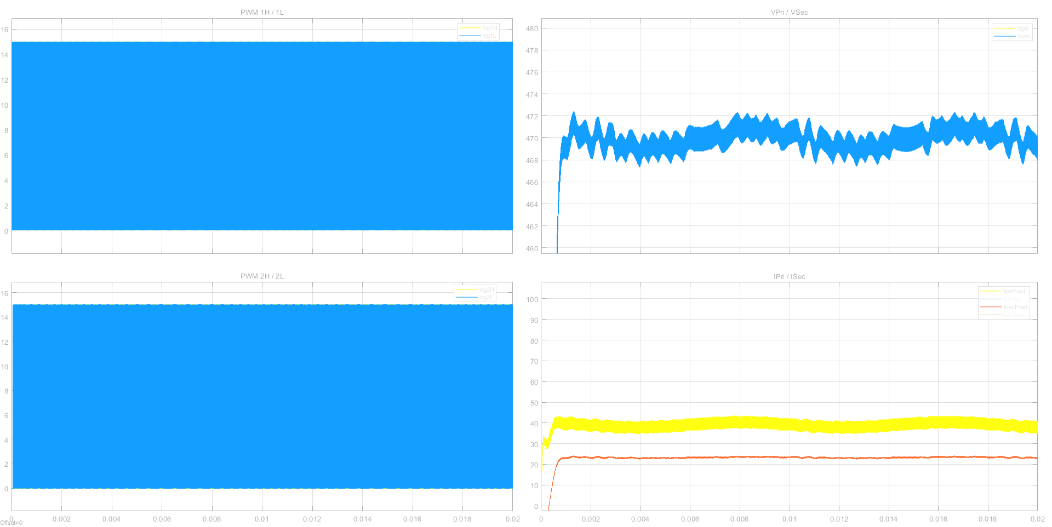
At 800V input with 30Vpp ripples at 120Hz, 470V output and 11kW,
Output ripple specs is +/-2% of output voltage.
At 470V, output ripple should be < +/-9.4V.

Slide 24
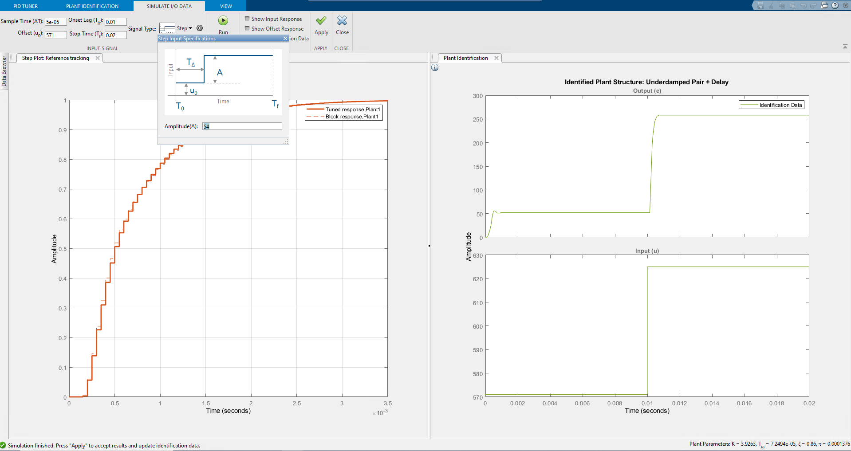
Control design using PID tuner – Settings for simulation run at 470V 11kW

Slide 25
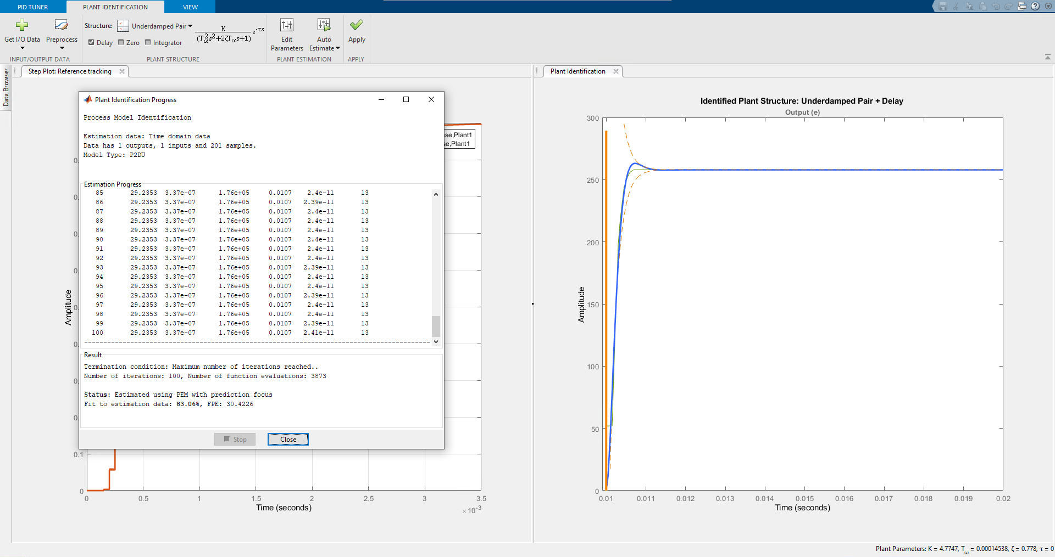
Control design using PID tuner – Plant identification

Slide 26
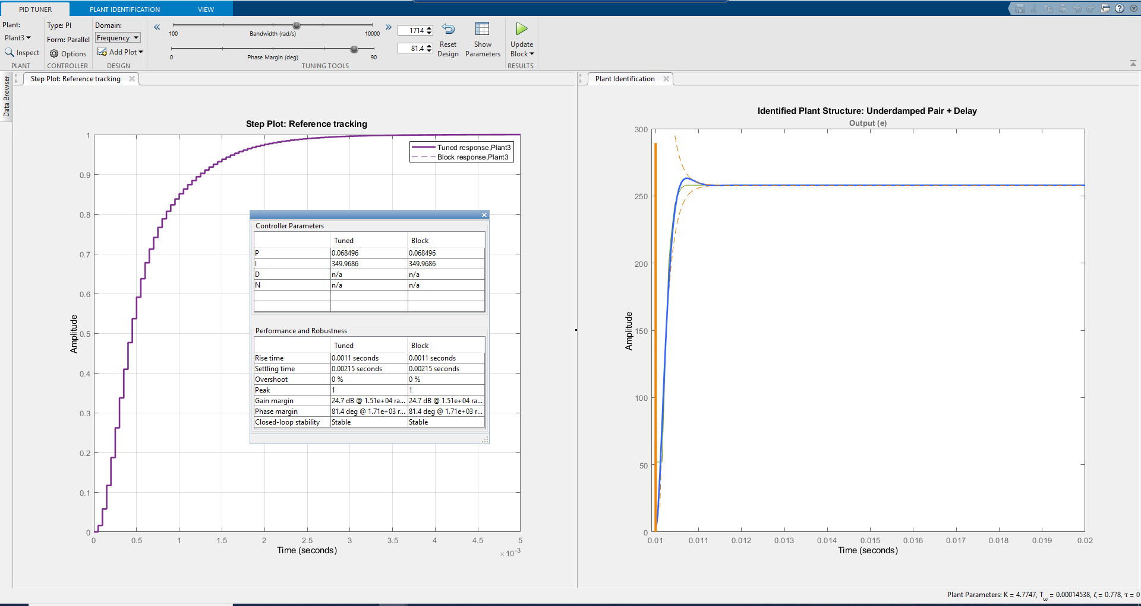
Control design using PID tuner – PID tuning

Slide 27
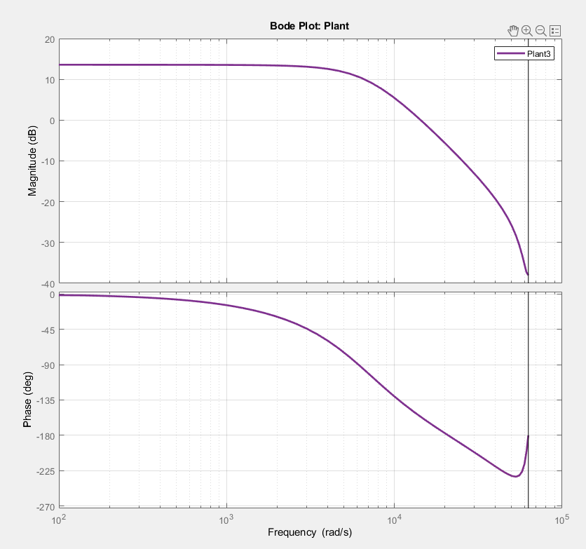
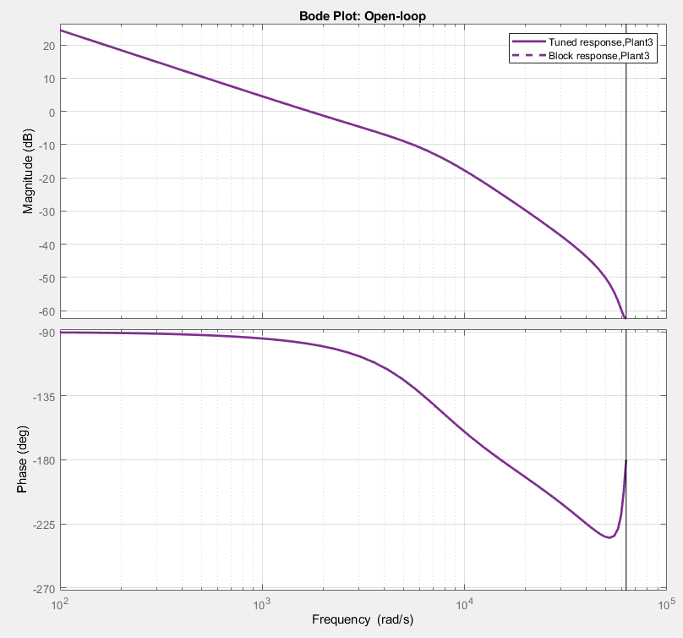
Bode plot of plant and Open loop bode plot

Slide 28
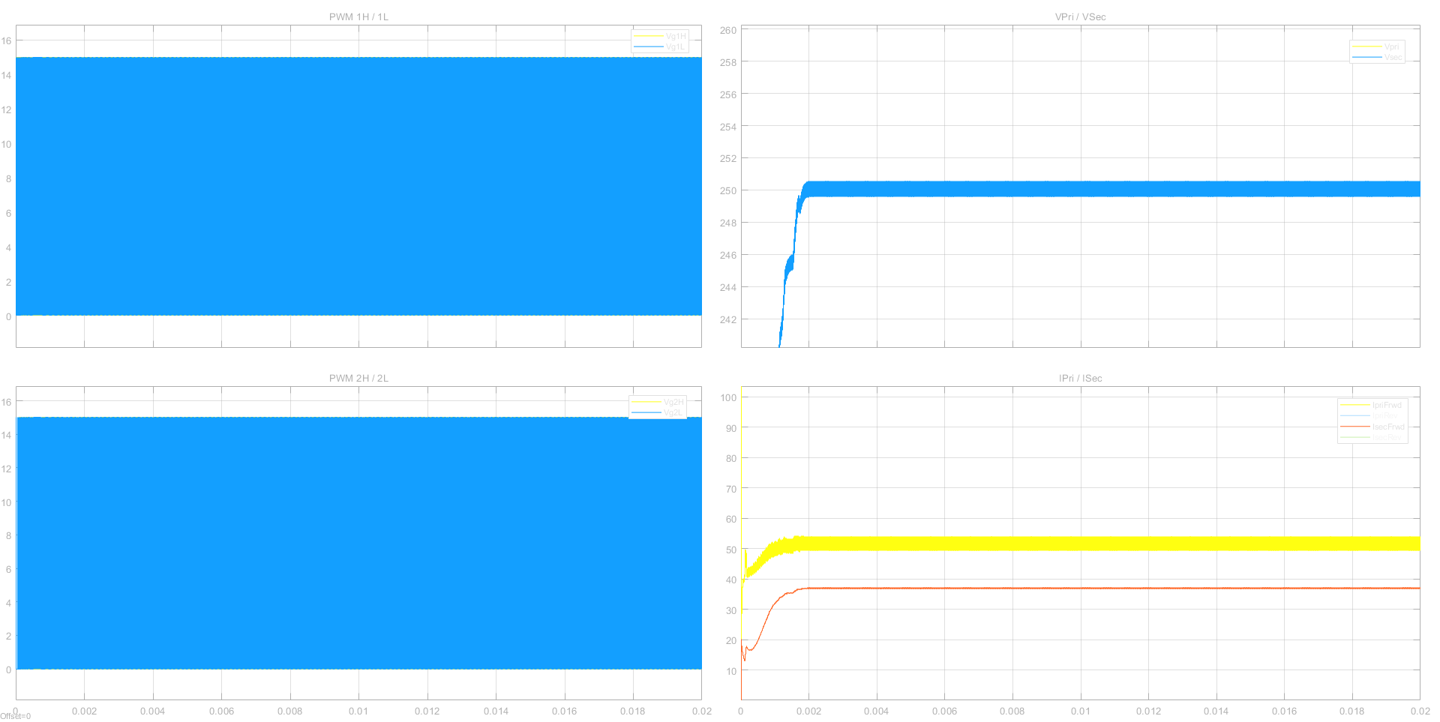
At 800V input, 250V output and 9.25kW,

Slide 29
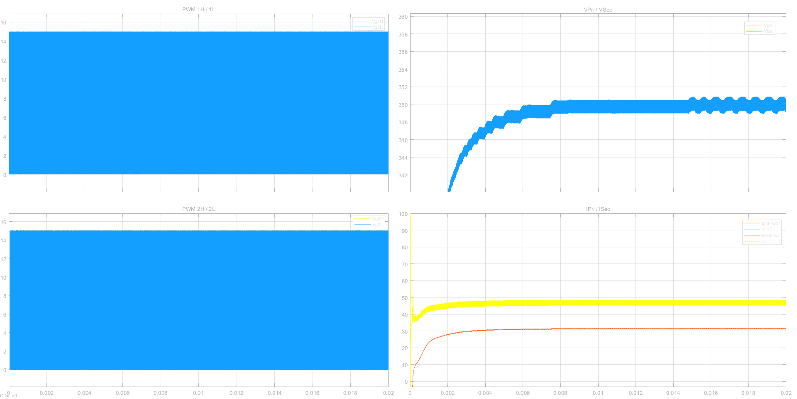
At 800V input, 350V output and 11kW,

Slide 30
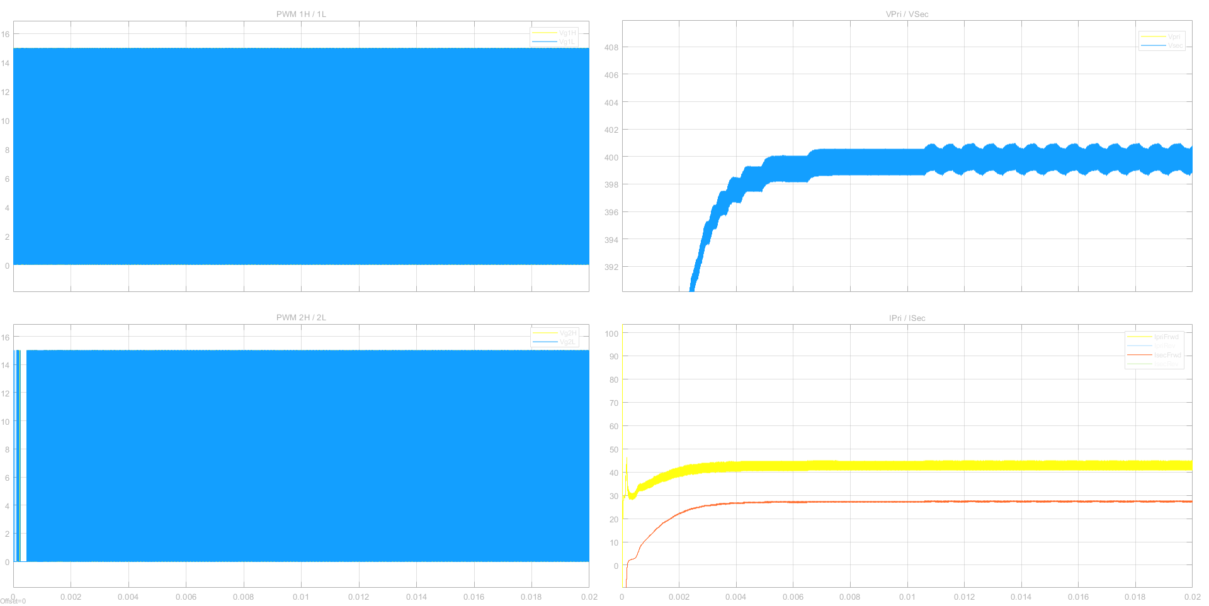
At 800V input, 400V output and 11kW,

Slide 31
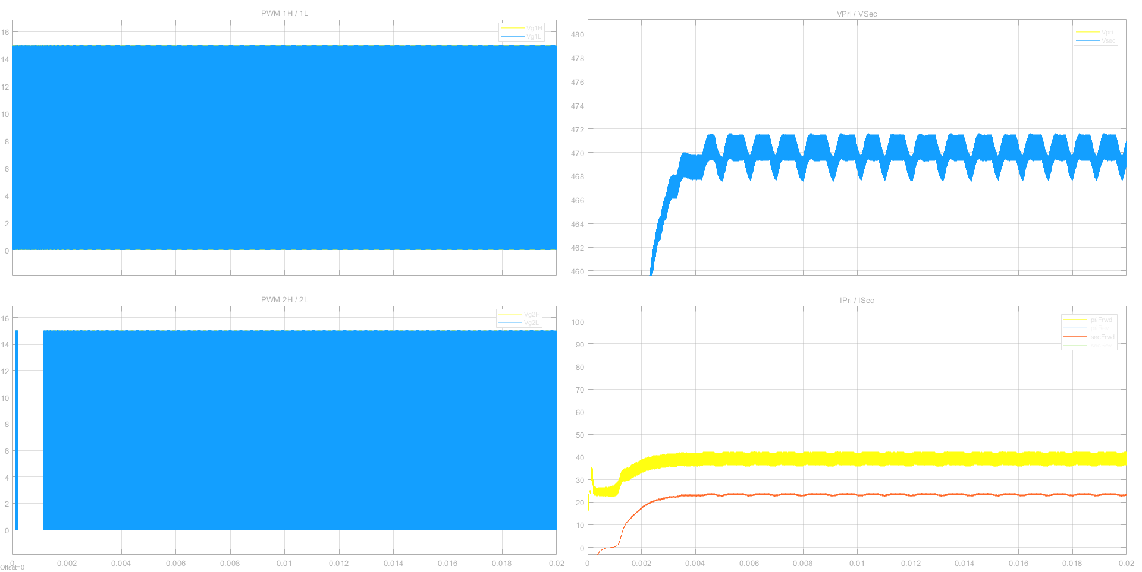
At 800V input, 470V output and 11kW,

